Slide 1

Scraping Yelp: Does Price Affect the Ratings of Restaurants in New York City?
NAME
ECO 590
Professor Kaltenberg

Slide 2
Motivation
According to the Office of the New York State Comptroller, the restaurant industry is a major source of employment in New York. 44% of the City’s residents work in the industry. Restaurants paid $10.7 billion in wages citywide, provided 317,000 jobs, and nearly $27 billion in taxes.
Yelp.com is one of the major review cite people would check before deciding which restaurant to go to.
I am interested in studying whether people prioritize the quality of the restaurant services, or the affordability of food.
Source: Office of the New York State Comptroller

Slide 3
Research Questions
1) Does the price range of a restaurant affect its rating on Yelp?
2) How does location affect the reviews or ratings of restaurant? Holding location constant, how will price affect the rating?
Source: Office of the New York State Comptroller

Slide 4
Key Variables
Number of Reviews: an indicator of the restaurant’s popularity
Rating: 1-5
Price Range: $/$$/$$$/$$$$
Borough: Manhattan/Queens/Brooklyn/Bronx/Staten Island

Slide 5
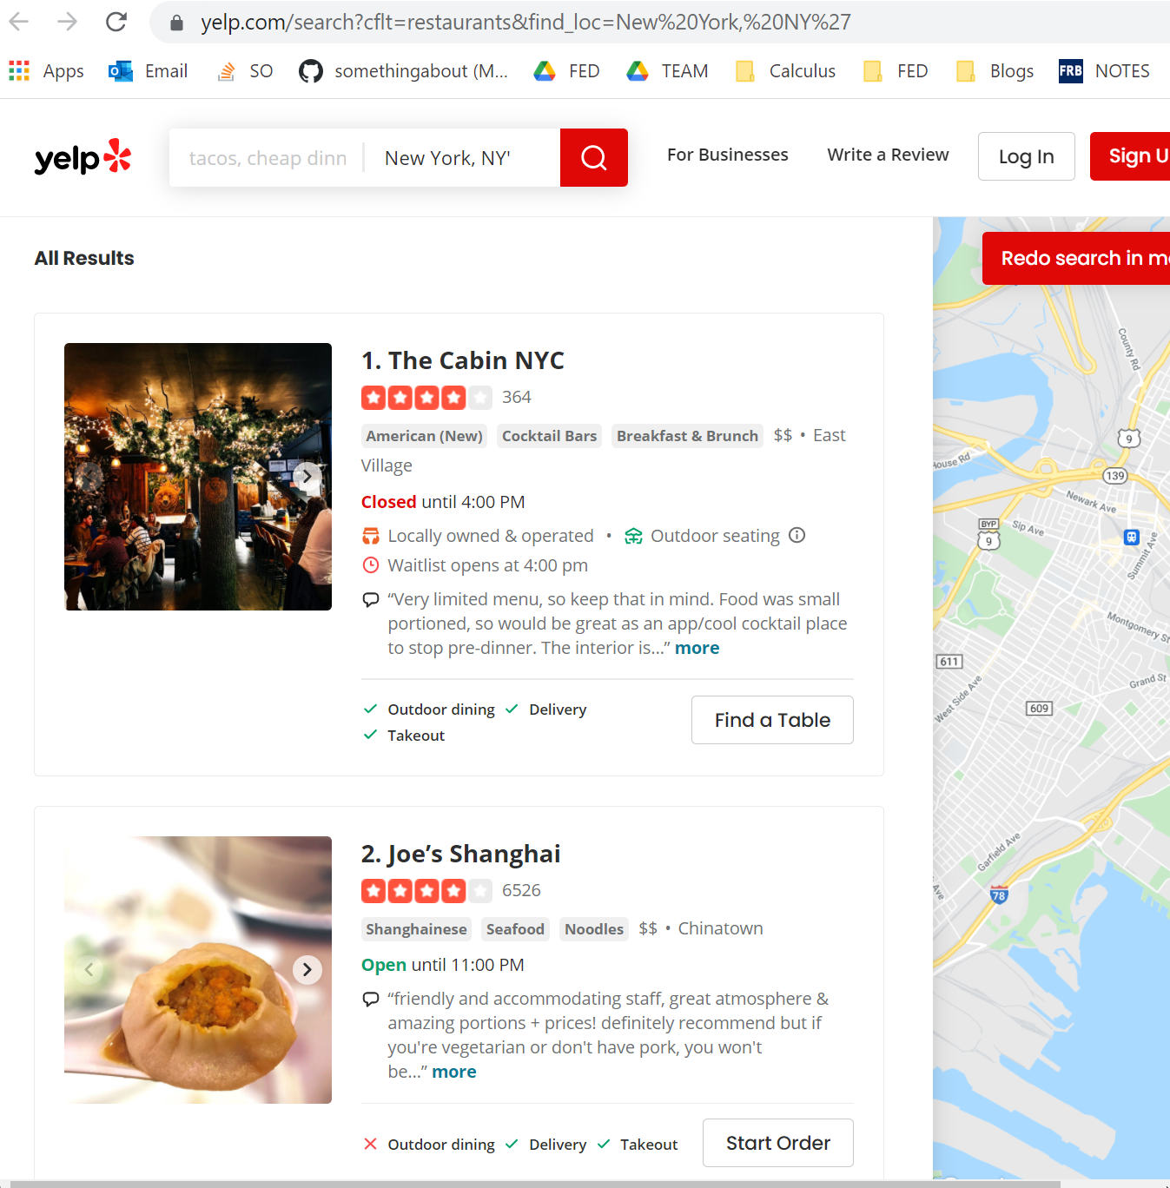

Web-scraping Yelp
Name of the Restaurant
Price Range
Rating
Number of Reviews
Location
Right click → “Inspect” to find out the classes information

Slide 6
Challenges in Web-scraping: Scraping more than one page using a for loop
The urls for different pages has a pattern:
Main Url:
'https://www.yelp.com/search?cflt=restaurants&find_loc=New%20York,%20NY’
1st Page: …find_loc=New%20York,%20NY&start=0
2nd Page: …find_loc=New%20York,%20NY&start=10
3rd Page: …find_loc=New%20York,%20NY&start=20
Each page has 10 results. “start=” is followed by the number of results that has already displayed in previous pages.

Slide 7
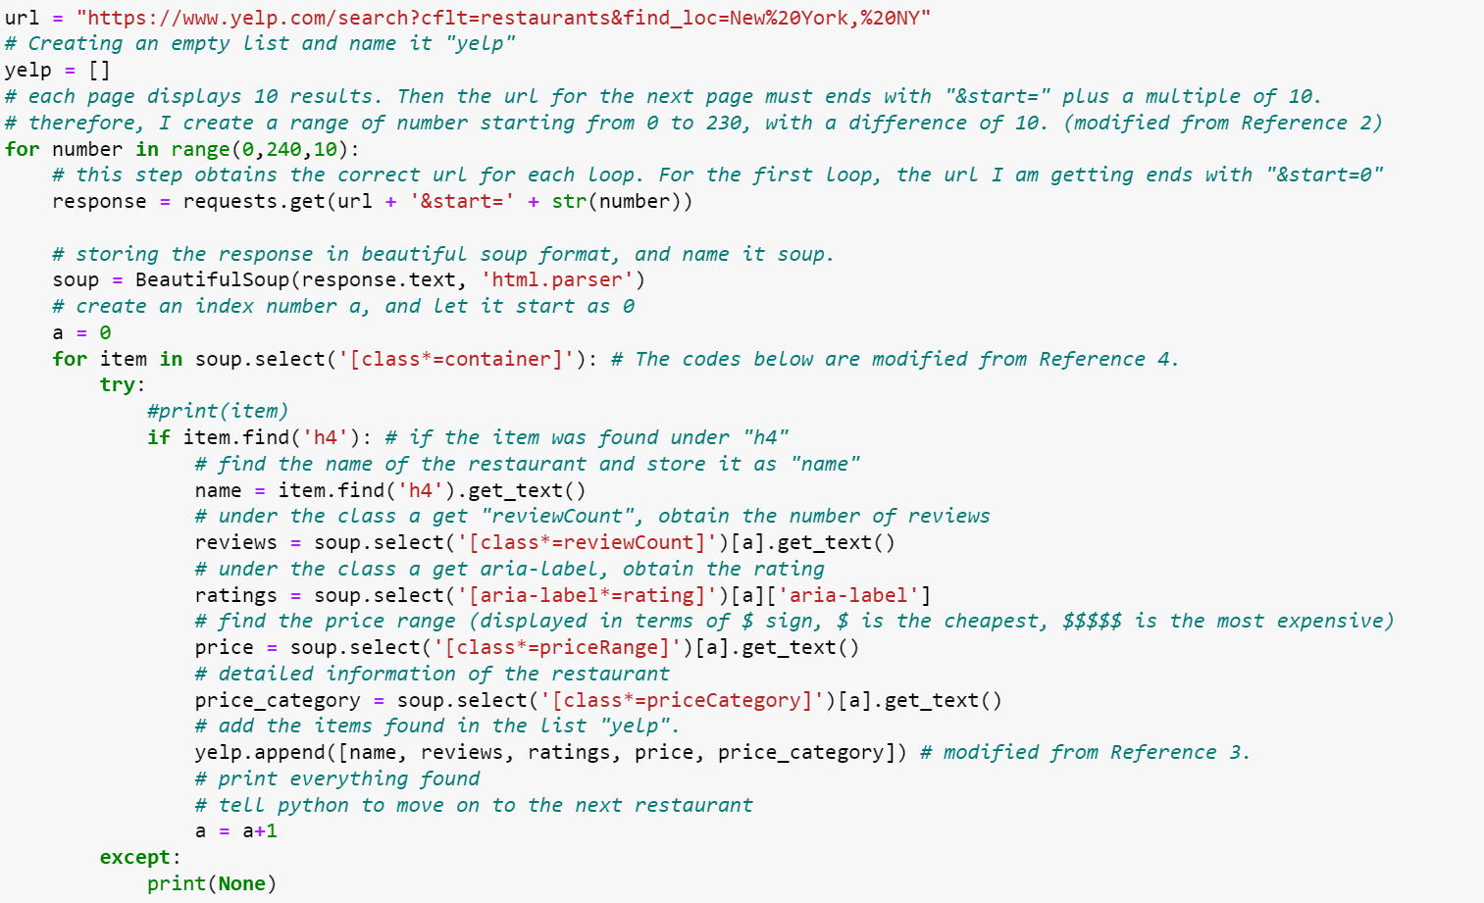
Create a list to store the results
Loop the pages by 0,10,20…240
Set loop index
A nested for loop to scrape results on each page
Restaurant Name
Number of Reviews
Rating
Price Range
Contains Location
Add everything to the list “yelp”
Tells Python after getting the above variables,
repeat the loop to get info for the next restaurant

Slide 8
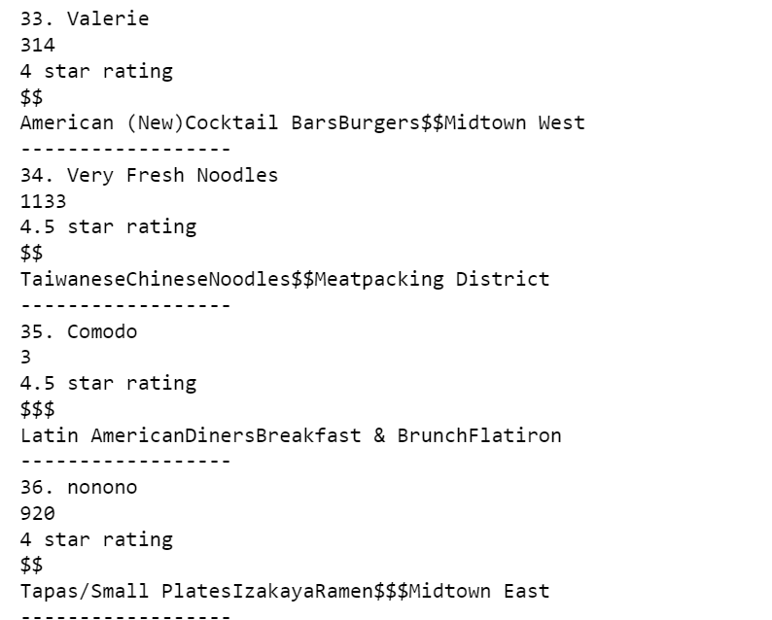
Sample Output
The output displays each restaurant’s information in the following order:
Name
Number of Reviews
Rating
Price Range
Detailed information that contains location

Slide 9
Challenges in Web-scraping: Yelp does not show all restaurants in NYC
Yelp is designed for diners who wants to find out the best restaurants in specific areas. Therefore, each search only returns 240 “best restaurants,” instead of all of the restaurants available.
Scraping restaurants in New York only returns 240 restaurants.
Instead, I scraped restaurants in each of the five boroughs in New York: Manhattan, Brooklyn, Queens, Bronx and Staten Island to obtain a larger sample size.
I stored my results in lists “yelp_m”, “yelp_b”, “yelp_q”, “yelp_bx”, and “yelp_s.”

Slide 10
Merging DataFrames
Turning the lists "yelp_m", "yelp_b", "yelp_q", "yelp_bx", and "yelp_s" - into dataframes and merge all four dataframes.
For Manhattan:
yelp_m = pd.DataFrame( yelp_m, columns = ["Names", "Number of Reviews", "Rating", "Price Range", "Detail"])
Create a new column "Borough" and fill each row with "Manhattan"
yelp_m["Borough"] = "Manhattan"
Merge into one dataframe and rename it as “yelp_df”
yelp_df = pd.concat([yelp_m, yelp_b, yelp_q, yelp_bx, yelp_s], axis=0)

Slide 11
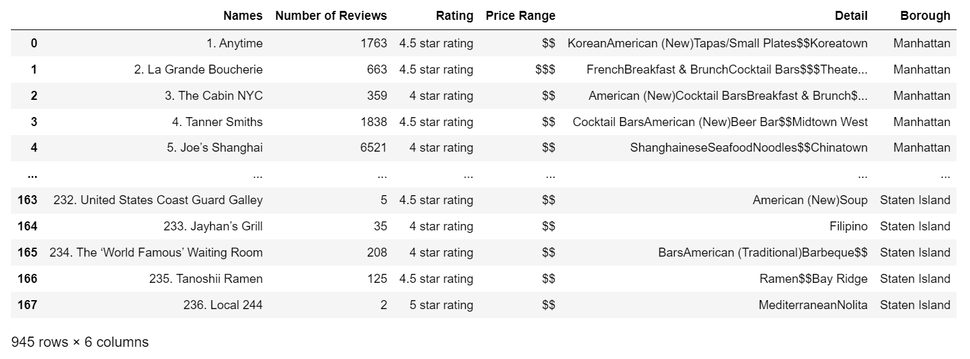
Output of the Combined DataFrame

Slide 12
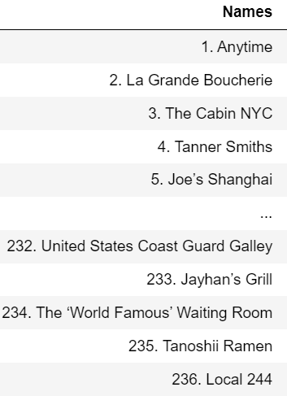
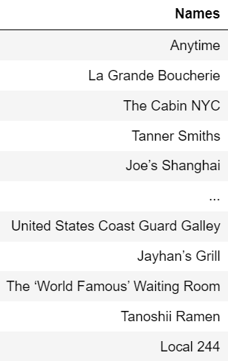
Data Cleaning - Names

Slide 13
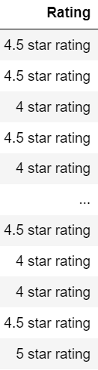

Data Cleaning - Ratings
Removing "star rating" from the column "Rating", by slicing the values up to the 12th item counting from the right.
yelp_df['Rating'] = yelp_df['Rating'].str[:-12]
The column "Rating" is still in string form. I use the to_numeric function to convert the column into float.
yelp_df['Rating'] = pd.to_numeric(yelp_df['Rating'], errors='coerce')

Slide 14
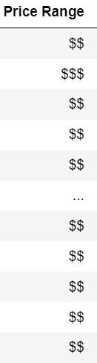
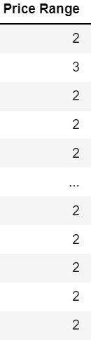
Data Cleaning – Price Range
To count the number of dollar signs in the column “Price Range”:
yelp_df["Price Range"] = yelp_df["Price Range"].str.count('\\$')

Slide 15
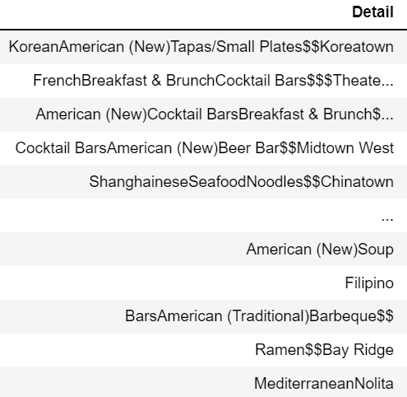
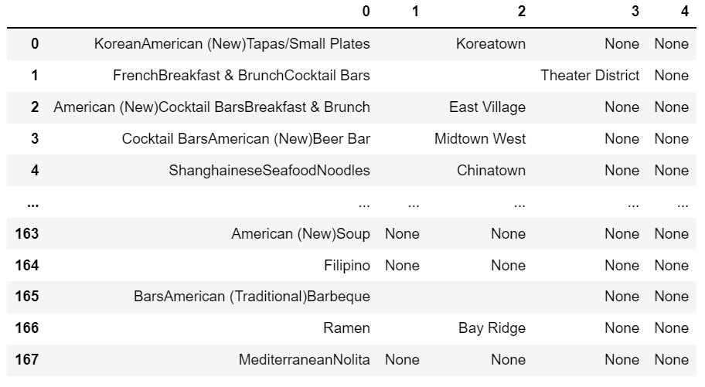
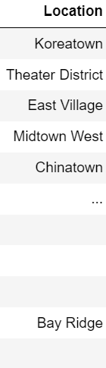
Adding a variable “Location”

Slide 16
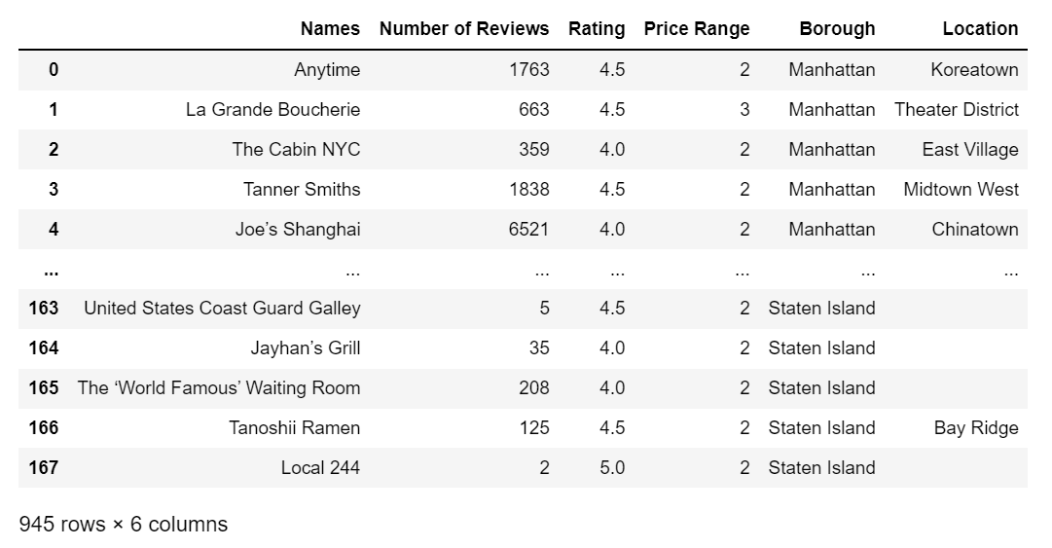
Finished Dataset

Slide 17
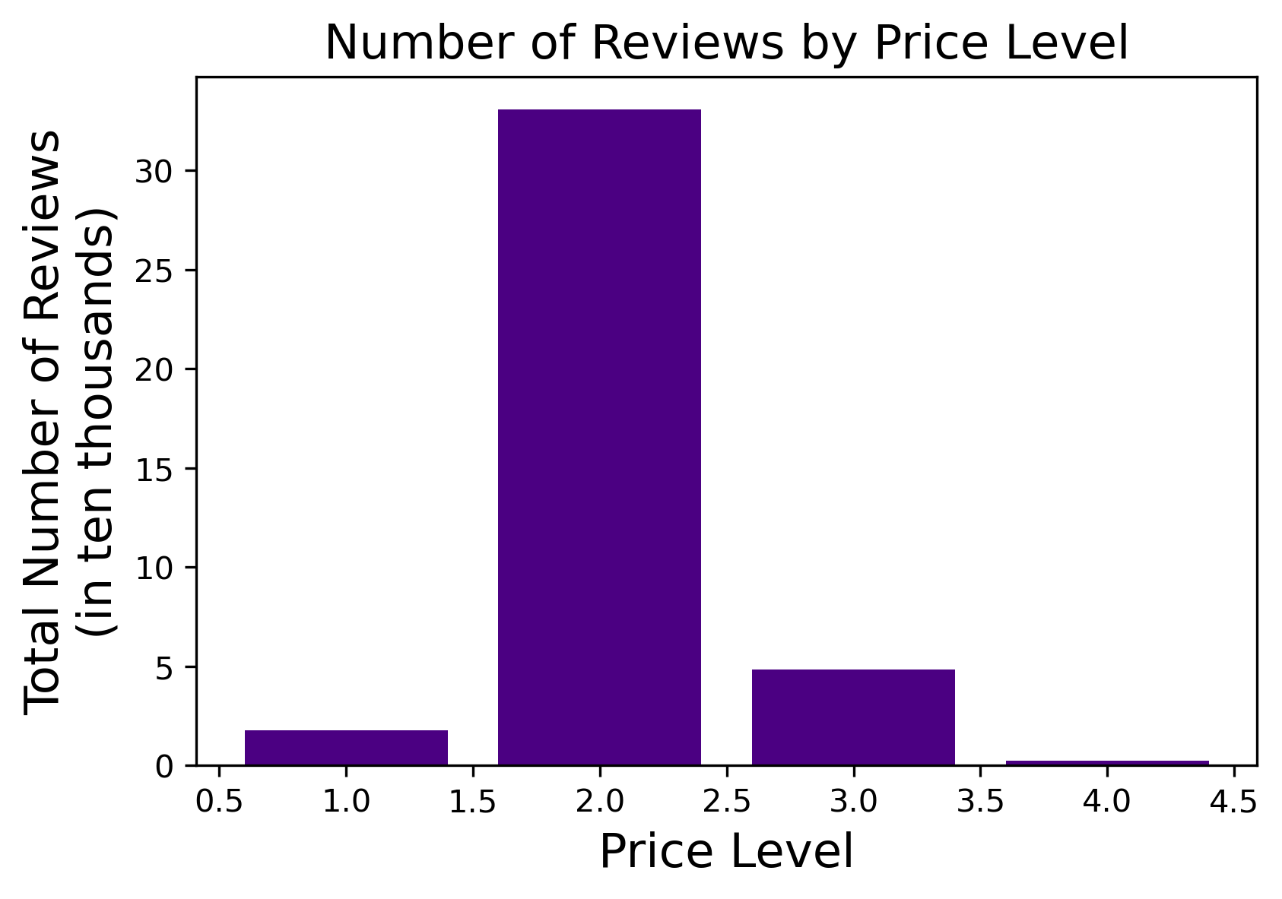

Slide 18
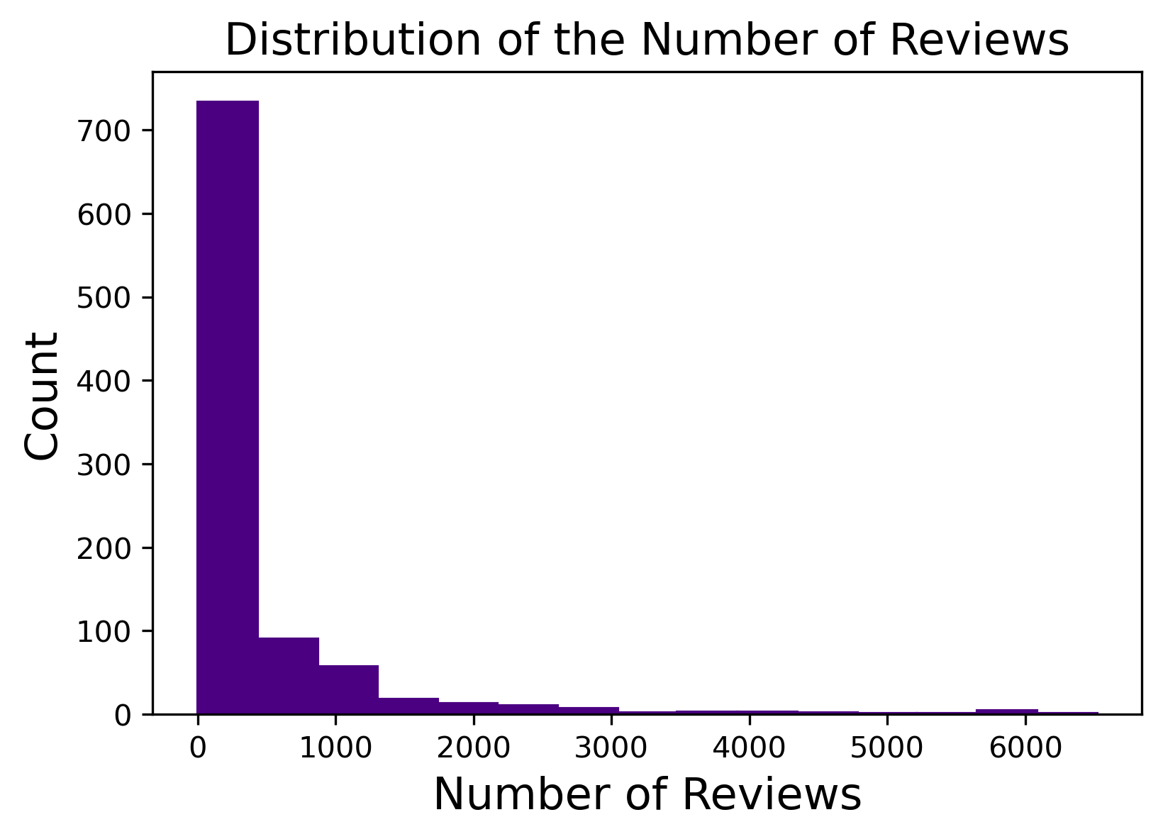
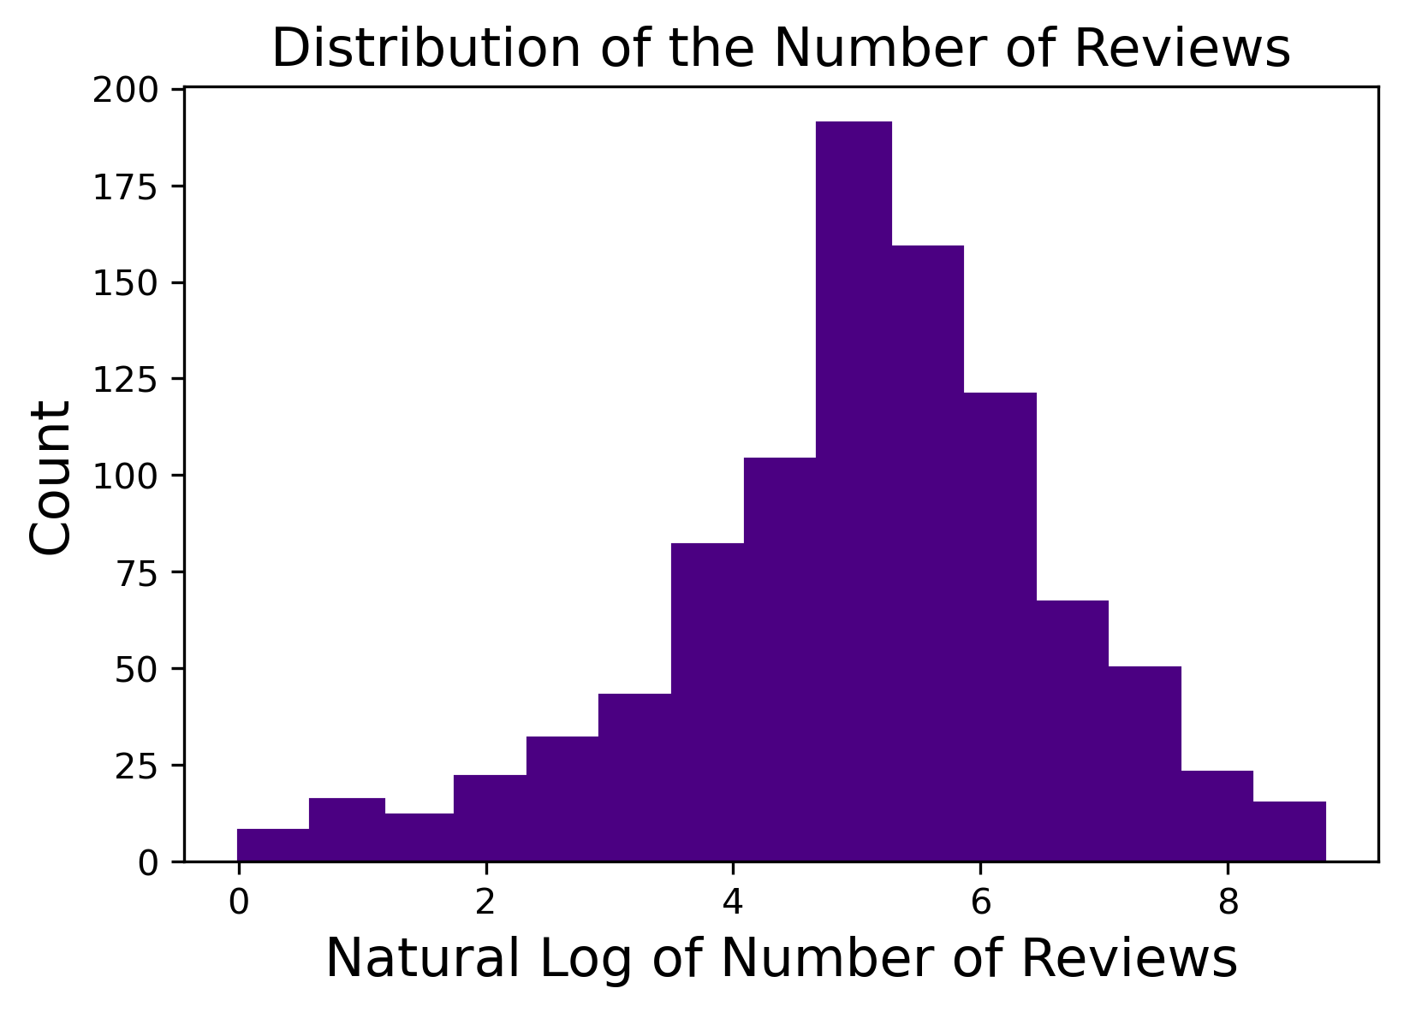
Putting the Number of Reviews on Log Scale

Slide 19
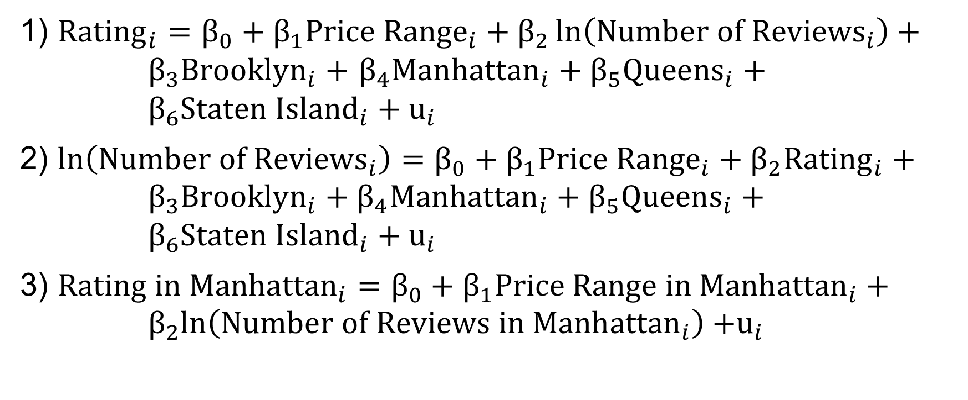
Models
1) ${Rating}_{i}=β_{0}+β_{1}{Price Range}_{i}+β_{2}\ln\left({Number of Reviews}_{i}\right)+ β_{3}{Brooklyn}_{i}+$ $β_{4}{Manhattan}_{i}+β_{5}{Queens}_{i}+ β_{6}{Staten Island}_{i}+u_{i}$
2) $\ln\left({Number of Reviews}_{i}\right)=β_{0}+β_{1}{Price Range}_{i}+β_{2}{Rating}_{i}+ β_{3}{Brooklyn}_{i}+β_{4}{Manhattan}_{i}+β_{5}{Queens}_{i}+ β_{6}{Staten Island}_{i}+u_{i}$
3) $Rating in{ Manhattan}_{i}=β_{0}+β_{1}Price Range in{ Manhattan}_{i}+{ β}_{2}\ln\left(Number of Reviews in{ Manhattan}_{i}\right)$ $+u_{i}$

Slide 20
Cross-Sectional Data Results
 | Rating | log of Number of Reviews | Rating in Manhattan
 | (1) | (2) | (3)
Price Range | 0.031 | -0.062 | -0.030
 | (0.025) | (0.095) | (0.040)
log of Number of Reviews | -0.089*** |  | -0.084***
 | (0.008) |  | (0.014)
Rating |  | -1.310***
 |  | (0.118)
BoroughBrooklyn | 0.142*** | 0.836***
 | (0.037) | (0.139)
BoroughManhattan | 0.221*** | 1.880***
 | (0.039) | (0.140)
BoroughQueens | 0.225*** | 0.994***
 | (0.037) | (0.139)
BoroughStaten Island | 0.087** | 0.177
 | (0.037) | (0.144)
Constant | 4.505*** | 9.944*** | 4.833***
 | (0.065) | (0.525) | (0.134)
Observations | 945 | 945 | 202
R² | 0.135 | 0.267 | 0.152
Adjusted R² | 0.129 | 0.262 | 0.143
Residual Std. Error | 0.349 (df = 938) | 1.340 (df = 938) | 0.286 (df = 199)
F Statistic | 24.340*** (df = 6; 938) | 56.969*** (df = 6; 938) | 17.778*** (df = 2; 199)
Note: *p<0.1; **p<0.05; ***p<0.01

Slide 21
Discussions
Regression 1 shows that holding the number of reviews and location of the restaurant constant, there is no significant effect of the change in price on the rating.
In addition, for each 100% additional reviews, a restaurant’s rating will fall by 0.09 stars.
Holding the number of reviews and price constant, restaurants in Queens have the highest average ratings, and restaurants in Bronx have the lowest ratings.

Slide 22
Discussions
Regression 2 shows that a 1-star increase in rating is associated with a 130% decline in the predicted number of reviews, holding price range and location constant.
Regression 3 shows that in Manhattan, for each 100% additional reviews, a restaurant’s rating will fall by 0.08 stars.

Slide 23
Conclusion and Future Study
There seems to be little impact of price on the number of reviews a restaurant receives.
The logarithm that Yelp uses to draw the best 240 restaurants in each borough is unknown, so that the collection of my sample is not randomized, and valuable observations may be omitted.
The number of reviews may not be a good indicator of the popularity of the restaurants, given that some restaurants may provide discounts or other way to incentivize customers to leave reviews.

Slide 24
Thank you!

Slide 25
Source:
Office of the New York State Comptroller: https://www.osc.state.ny.us/files/reports/osdc/pdf/nyc-restaurant-industry-final.pdf

